Slide 1

RATEOPIA
Supervised by
Dr. Sanaa Mohamed Ahmed
Implemented by
Muhannad Atef Soliman 20185005
Mohamed Amr Abdelhalim 20185002
Mostafa Abdelhamid Fahim 20185004
Ibrahim Medhat Talha 20185014
Ahmed Hazem Salah 20185011
Eslam Ahmed Ramadan 20185001

Slide 2

The Problem, the solution & the idea.
The problem
Under reported crimes in Egypt.
Fear of reporter’s identity reveal.
Difficulty of gathering information about candidates.
Diseasing moral code of citizens of society.
The Solution
Easier and faster Crime Reporting.
The report will be in anonymous way to protect the identity of the reporter.
A way for employers to gather information as much as possible for new hire candidates.
Due to the strict rating system, people will follow rules more often.
The Idea
Citizens are rated according to their ethics and behavior.
A system that helps citizens report anonymously.
Employers will check the history of any candidate in an easier manner by checking candidates’ dashboard page.
Showing the rating publicly for all users to see.

Slide 3
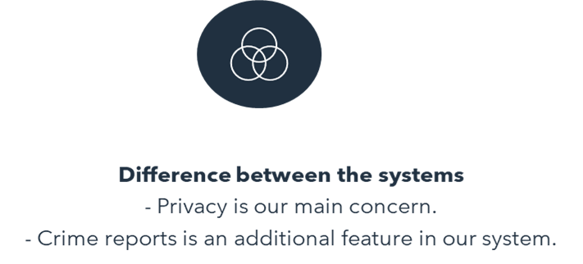
Related work & the difference
Social credit system
- A Chinese system for rating citizens.

Slide 4
Tools and Features
Database.
Friendly user interface.
Administrator interface.
Face recognition

Slide 5
Functional Requirements
Citizen functional requirements
Administrator functional requirements
First Functional requirements that are used on the website are divided in two types.
Citizen Functional requirements
Citizen functional requirements are the features that the user can only do at the website.
Admin Functional requirements
Admin functional requirements are the features that the admin can do at the website and how to react to anything done by the citizen.

Slide 6
Citizen functional requirements
Login
Contact website
Forget the password
Report user
Modify
Request Modify address
Get notification of recent changes
Check his rating
Search user
Name
Location
Photo or video
Physical features
ID
By:-
Phone
Car plate number
Job

Slide 7
Admin Functional Requirements
Login.
ADD New Users.
Maintains website.
Modifies rating.
Sends critical reports to authorities.
Updates website.
Sends initial user’s login passwords.

Slide 8
Non-Functional Requirements
Portability and Compatibility
In our website it’s portable and compatible as it’s web app
Performance
The performance depends on the server and the number of the users using the website simultaneously.
Reliability, availability, maintainability
With small number of users, the system is not expected to face any critical failures and if existed it can be handled as fast as possible. Our system is available all the time.
Usability
Our system is user friendly, as it has an easy-to-use interface.
Security
Our system will use encryption and decryption techniques and message authentication techniques.

Slide 9
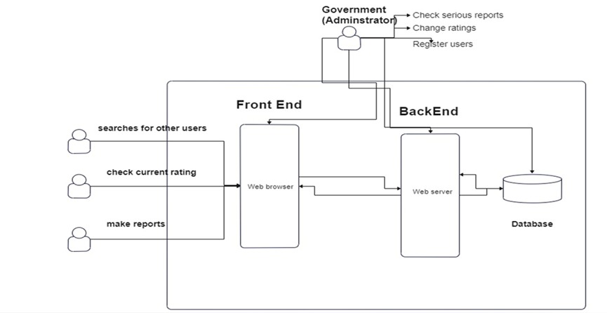
System Architecture

Slide 10

Implementation
In this section we will talk about
our website and the pages in it.

Slide 11
Website
Frontend
- Admin website.
- Citizen website.
Backend
- Database.
- Folders.

Slide 12
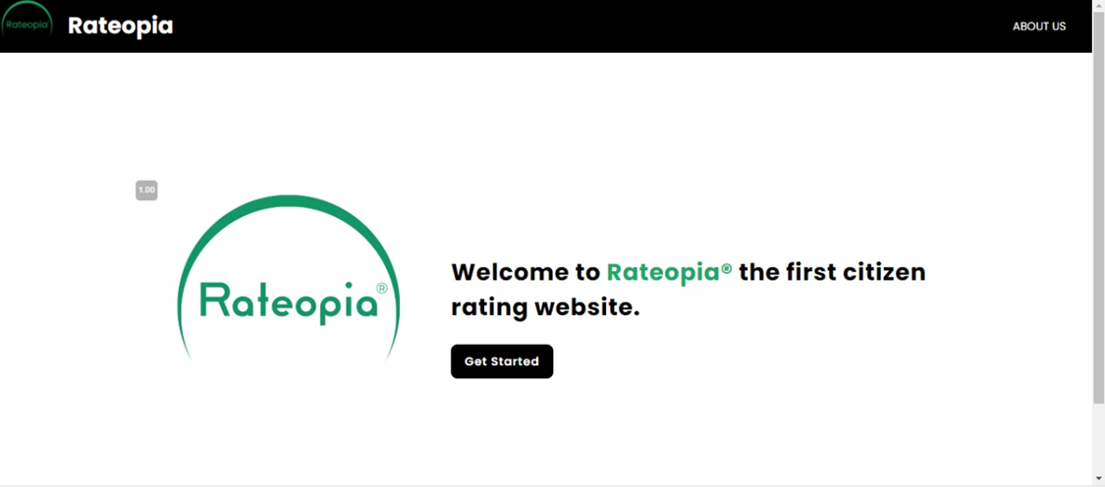
Citizen front End
Login page.
Dashboard page.
Edit info page.
Search page.
Make report page.
Recent reports page
Change password page
Contact us

Slide 13
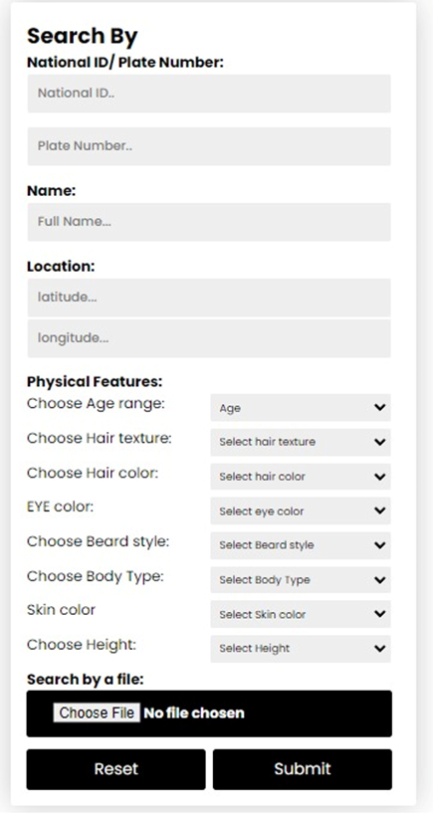
Search
Plate Number
Location
Physical Features
Video
Image
National ID
Name
National ID: Search by the National ID.
Plate number: Search by the plate number.
Name: Search by the citizen’s name.
Location: Searches by the location of the incident.
Physical features: If the user doesn’t have any info about the citizen, he wants to report he just enters his/her features.
Video or image: If the user enters a video or an image our face detector detects the citizen and provides the user with the results.

Slide 14
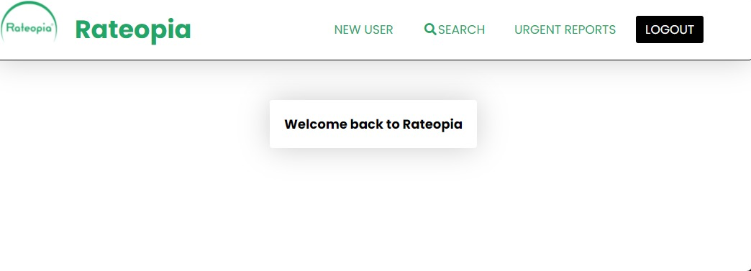
Admin Front end.
Create account.
Edit users' info and rate.
Receive urgent reports and sends them to authorities.

Slide 15
Face recognition
OpenCv library.
How is it useful for our project.
It’s implementation in our project.
OpenCv is a library in python that we use to detect faces in any video or image and compare these faces to the images we have in the database.
It is useful in the search as we implemented it to make the search easier and more efficient .

Slide 16
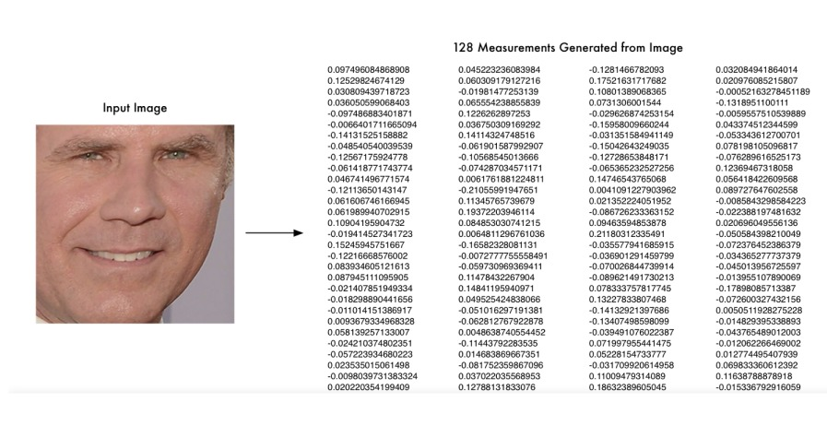
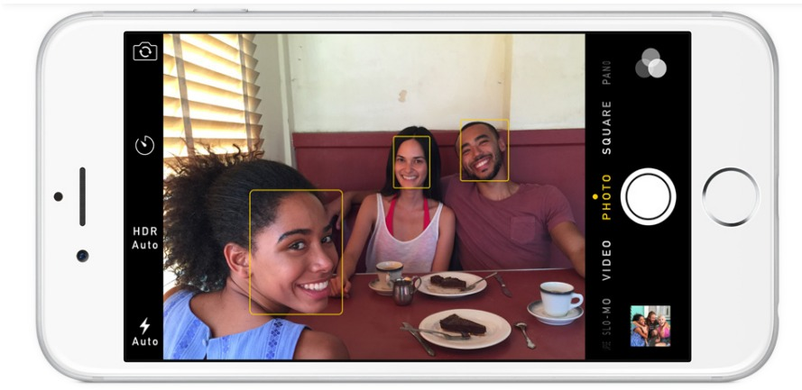
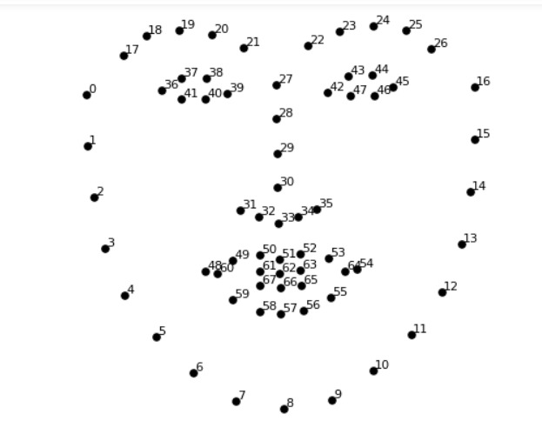
Steps of face recognition
First step face detection.
Second step face landmark detection and centralizing face.
Third step face encoding.

Slide 17
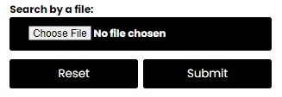

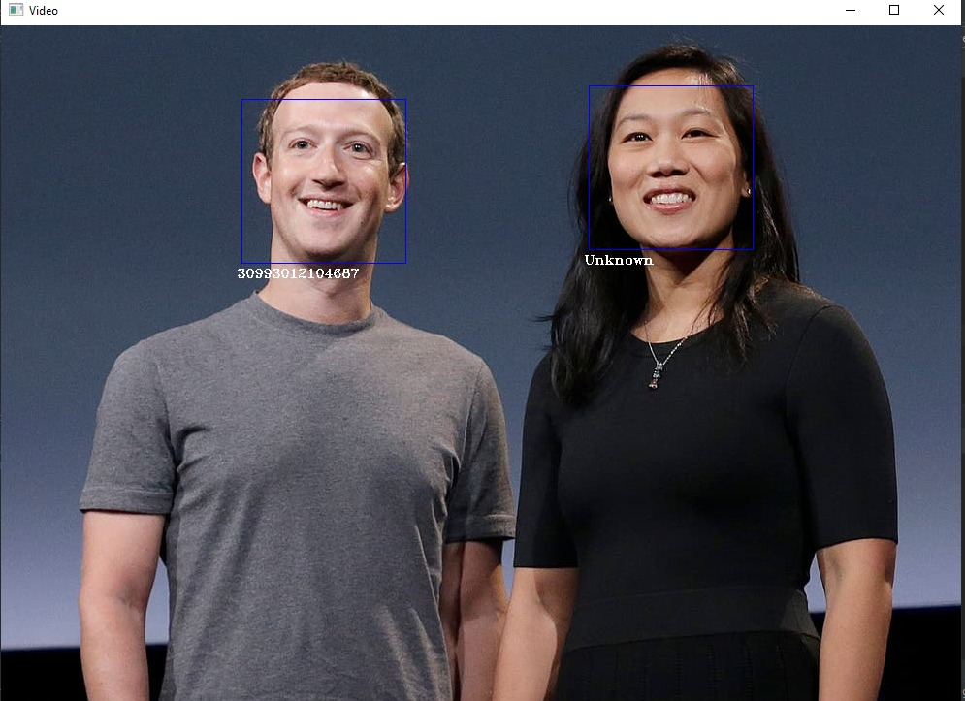
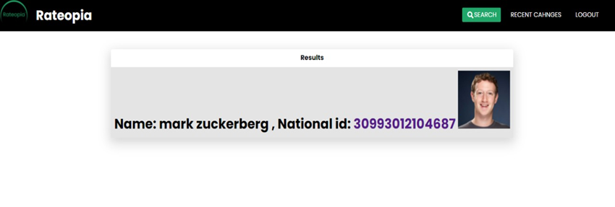
Example on the search by face recognition
If someone wants to report a user and he/she has an image or video for him/her
first attach the file
Then the system will compare the image/video with the images
in the database if the user exists the national id will be detected if not it will appear unknown.

Slide 18
Backend
Database
- Systems database to store users’ information , admin’s information and reports.
Folders
- To store citizens’ images.
- To save the attached documents files with reports.

Slide 19
Future work
Security system
Message authentication codes for reports
Hash function for passwords.
Penetration tests to test the security of the system.
Rating system
Automation for rating system update and for calculating the rate after each report.
Organization request
Organization can request previous report script on their job candidates for further background checking.
Security system
Rating System
Organization request

Slide 20

DEMO

Slide 21

Thank you for your time.

